Slide 1
Cloud Computing: Open Stack Part I
Vijay Dialani, PhD
Boise State University
vijaydialani@boisestate.edu
©All rights reserved by the author

Slide 2
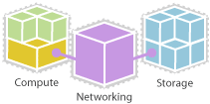
Open Stack

Slide 3
Open Stack Cloud features
On-demand self-service: Users can automatically provision needed computing capabilities, such as server time and network storage, without requiring human interaction with each service provider.
Network access: Any computing capabilities are available over the network. Many different devices are allowed access through standardized mechanisms.
Resource pooling: Multiple users can access clouds that serve other consumers according to demand.
Elasticity: Provisioning is rapid and scales out or is based on need.
Metered or measured service: Cloud systems can optimize and control resource use at the level that is appropriate for the service. Services include storage, processing, bandwidth, and active user accounts. Monitoring and reporting of resource usage provides transparency for both the provider and consumer of the utilized service.

Slide 4
Service Models
Cloud computing offers different service models depending on the capabilities a consumer may require.
SaaS: Software as a Service. Provides the consumer the ability to use the software in a cloud environment, such as web-based email for example.
PaaS: Platform as a Service. Provides the consumer the ability to deploy applications through a programming language or tools supported by the cloud platform provider. An example of platform as a service is an Eclipse/Java programming platform provided with no downloads required.
IaaS: Infrastructure as a Service. Provides infrastructure such as computer instances, network connections, and storage so that people can run any software or operating system.

Slide 5
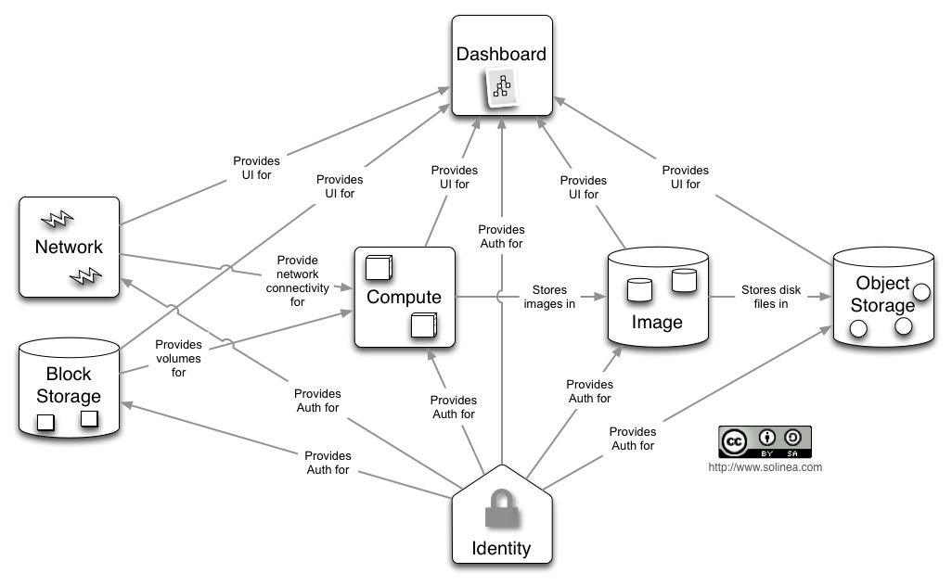
Conceptual Architecture
Notes:
Compute
Nova is the most complicated and distributed component of OpenStack. A large number of processes cooperate to turn end user API requests into running virtual machines. Below is a list of these processes and their functions:
nova-api accepts and responds to end user compute API calls. It supports OpenStack Compute API, Amazon's EC2 API and a special Admin API (for privileged users to perform administrative actions). It also initiates most of the orchestration activities (such as running an instance) as well as enforces some policy (mostly quota checks).
The nova-compute process is primarily a worker daemon that creates and terminates virtual machine instances via hypervisor's APIs (XenAPI for XenServer/XCP, libvirt for KVM or QEMU, VMwareAPI for VMware, etc.). The process by which it does so is fairly complex but the basics are simple: accept actions from the queue and then perform a series of system commands (like launching a KVM instance) to carry them out while updating state in the database.
nova-volume manages the creation, attaching and detaching of z volumes to compute instances (similar functionality to Amazon’s Elastic Block Storage). It can use volumes from a variety of providers such as iSCSI or Rados Block Device in Ceph. A new OpenStack project, Cinder, will eventually replace nova-volume functionality. In the Folsom release, nova-volume and the Block Storage service will have similar functionality.
The nova-network worker daemon is very similar to nova-compute and nova-volume. It accepts networking tasks from the queue and then performs tasks to manipulate the network (such as setting up bridging interfaces or changing iptables rules). This functionality is being migrated to Quantum, a separate OpenStack service. In the Folsom release, much of the functionality will be duplicated between nova-network and Quantum.
The nova-schedule process is conceptually the simplest piece of code in OpenStack Nova: it takes a virtual machine instance request from the queue and determines where it should run (specifically, which compute server host it should run on).
The queue provides a central hub for passing messages between daemons. This is usually implemented with RabbitMQ today, but could be any AMPQ message queue (such as Apache Qpid). New to the Folsom release is support for Zero MQ.
The SQL database stores most of the build-time and runtime state for a cloud infrastructure. This includes the instance types that are available for use, instances in use, networks available and projects. Theoretically, OpenStack Nova can support any database supported by SQL-Alchemy but the only databases currently being widely used are sqlite3 (only appropriate for test and development work), MySQL and PostgreSQL.
Nova also provides console services to allow end users to access their virtual instance's console through a proxy. This involves several daemons (nova-console, nova-novncproxy and nova-consoleauth).
Nova interacts with many other OpenStack services: Keystone for authentication, Glance for images and Horizon for web interface. The Glance interactions are central. The API process can upload and query Glance while nova-compute will download images for use in launching images.
Object Store
The swift architecture is very distributed to prevent any single point of failure as well as to scale horizontally. It includes the following components:
Proxy server (swift-proxy-server) accepts incoming requests via the OpenStack Object API or just raw HTTP. It accepts files to upload, modifications to metadata or container creation. In addition, it will also serve files or container listing to web browsers. The proxy server may utilize an optional cache (usually deployed with memcache) to improve performance.
Account servers manage accounts defined with the object storage service.
Container servers manage a mapping of containers (i.e folders) within the object store service.
Object servers manage actual objects (i.e. files) on the storage nodes.
There are also a number of periodic processes which run to perform housekeeping tasks on the large data store. The most important of these is the replication services, which ensures consistency and availability through the cluster. Other periodic processes include auditors, updaters and reapers.
Authentication is handled through configurable WSGI middleware (which will usually be Keystone).
Image Store
The Glance architecture has stayed relatively stable since the Cactus release. The biggest architectural change has been the addition of authentication, which was added in the Diablo release. Just as a quick reminder, Glance has four main parts to it:
glance-api accepts Image API calls for image discovery, image retrieval and image storage.
glance-registry stores, processes and retrieves metadata about images (size, type, etc.).
A database to store the image metadata. Like Nova, you can choose your database depending on your preference (but most people use MySQL or SQlite).
A storage repository for the actual image files. In the diagram above, Swift is shown as the image repository, but this is configurable. In addition to Swift, Glance supports normal filesystems, RADOS block devices, Amazon S3 and HTTP. Be aware that some of these choices are limited to read-only usage.
There are also a number of periodic processes which run on Glance to support caching. The most important of these is the replication services, which ensures consistency and availability through the cluster. Other periodic processes include auditors, updaters and reapers.
As you can see from the diagram in the Conceptual Architecture section, Glance serves a central role to the overall IaaS picture. It accepts API requests for images (or image metadata) from end users or Nova components and can store its disk files in the object storage service, Swift.
Identity
Keystone provides a single point of integration for OpenStack policy, catalog, token and authentication.
keystone handles API requests as well as providing configurable catalog, policy, token and identity services.
Each Keystone function has a pluggable backend which allows different ways to use the particular service. Most support standard backends like LDAP or SQL, as well as Key Value Stores (KVS).
Most people will use this as a point of customization for their current authentication services.
Network
Quantum provides "network connectivity as a service" between interface devices managed by other OpenStack services (most likely Nova). The service works by allowing users to create their own networks and then attach interfaces to them. Like many of the OpenStack services, Quantum is highly configurable due to it's plug-in architecture. These plug-ins accommodate different networking equipment and software. As such, the architecture and deployment can vary dramatically. In the above architecture, a simple Linux networking plug-in is shown.
quantum-server accepts API requests and then routes them to the appropriate quantum plugin for action.
Quantum plugins and agents perform the actual actions such as plugging and unplugging ports, creating networks or subnets and IP addressing. These plugins and agents differ depending on the vendor and technologies used in the particular cloud. Quantum ships with plugins and agents for: Cisco virtual and physical switches, Nicira NVP product, NEC OpenFlow products, Openvswitch, Linux bridging and the Ryu Network Operating System.
The common agents are L3 (layer 3), DHCP (dynamic host IP addressing) and the specific plug-in agent.
Most Quantum installations will also make use of a messaging queue to route information between the quantum-server and various agents as well as a database to store networking state for particular plugins.
Quantum will interact mainly with Nova, where it will provide networks and connectivity for its instances.
Block Storage
Cinder separates out the persistent block storage functionality that was previously part of OpenStack Compute (in the form of nova-volume) into it's own service. The OpenStack Block Storage API allows for manipulation of volumes, volume types (similar to compute flavors) and volume snapshots.
cinder-api accepts API requests and routes them to cinder-volume for action.
cinder-volume acts upon the requests by reading or writing to the Cinder database to maintain state, interacting with other processes (like cinder-scheduler) through a message queue and directly upon block storage providing hardware or software. It can interact with a variety of storage providers through a driver architecture. Currently, there are drivers for IBM, SolidFire, NetApp, Nexenta, Zadara, linux iSCSI and other storage providers.
Much like nova-scheduler, the cinder-scheduler daemon picks the optimal block storage provider node to create the volume on.
Cinder deployments will also make use of a messaging queue to route information between the cinder processes as well as a database to store volume state

Slide 6
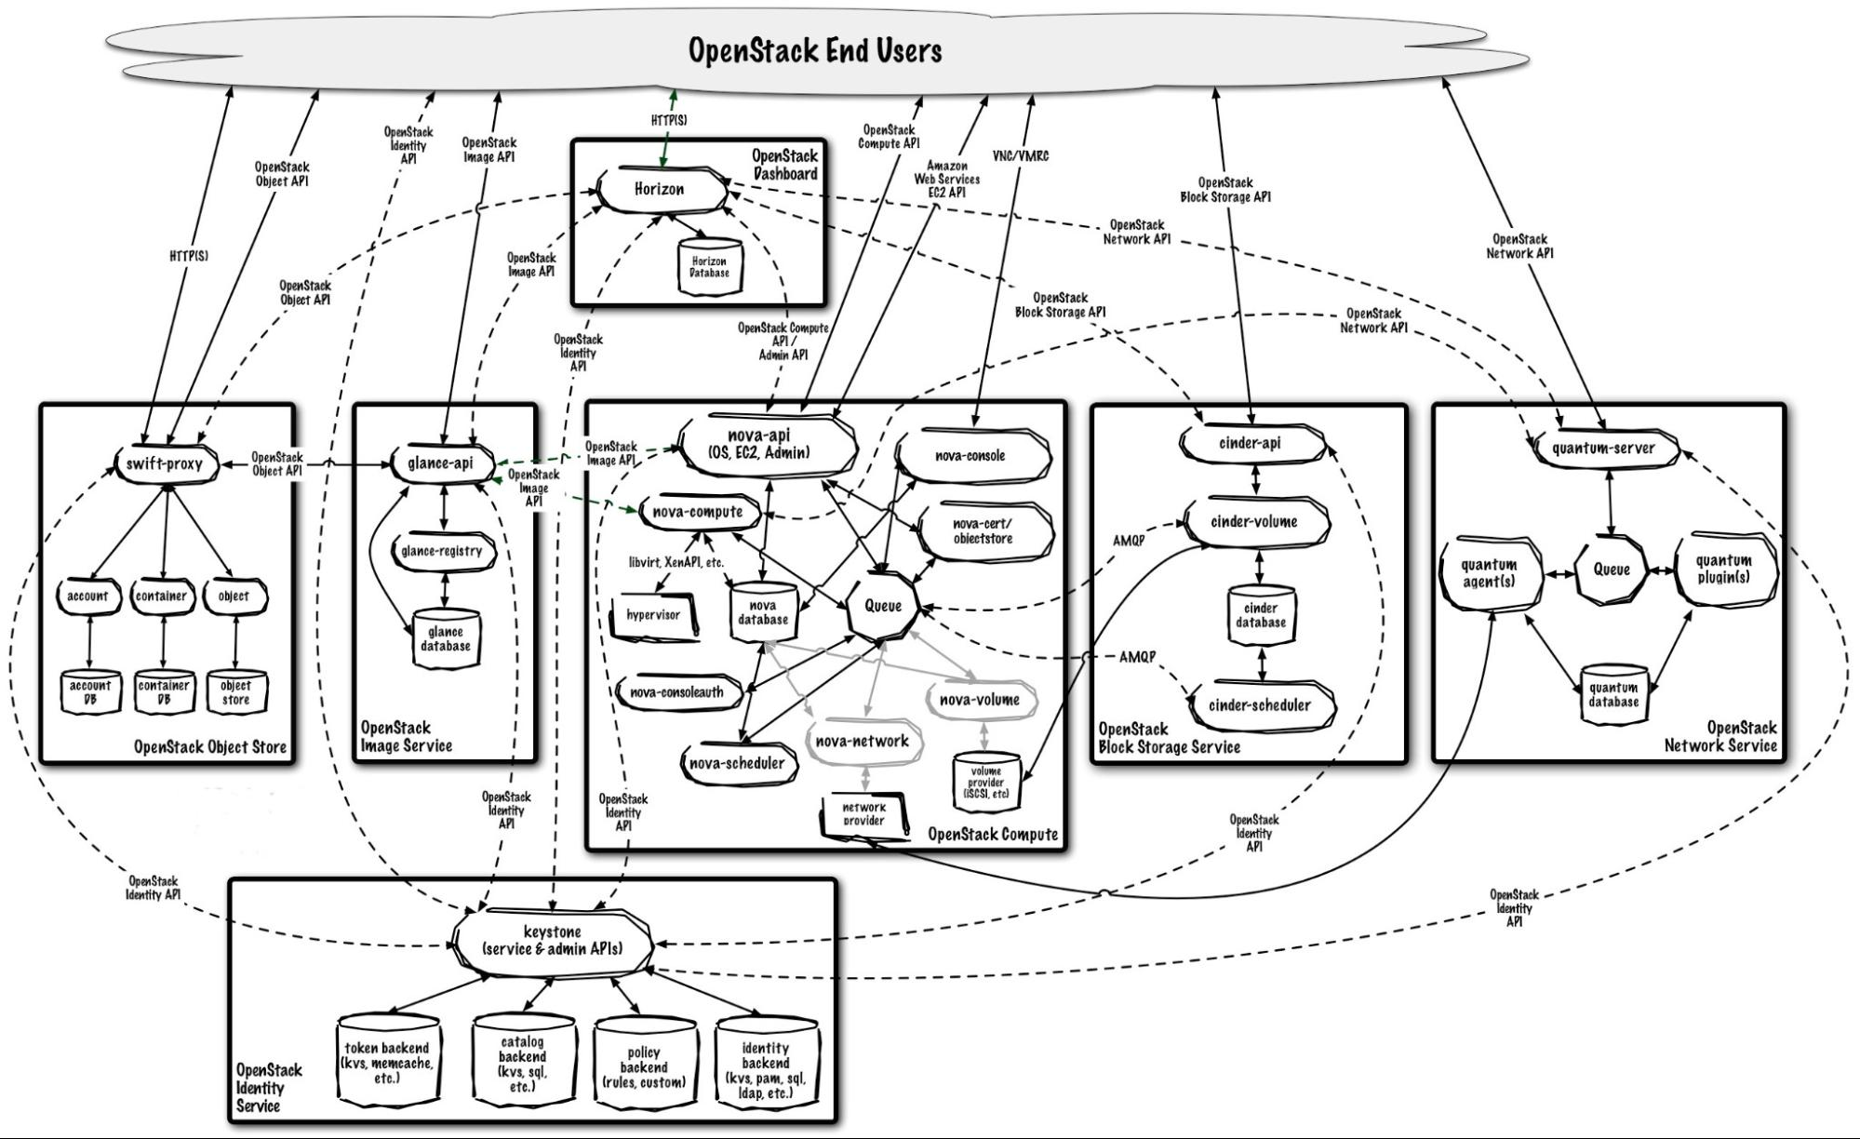
Open Stack Logical Architecture

Slide 7
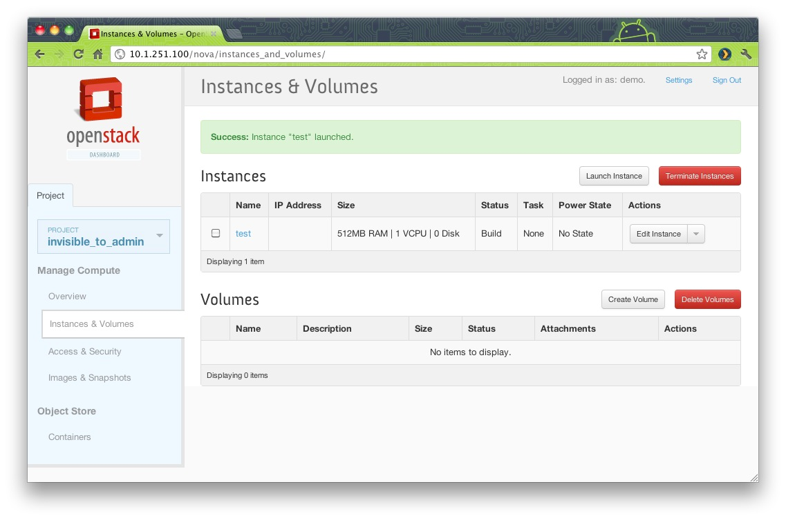
Dashboard

Slide 8
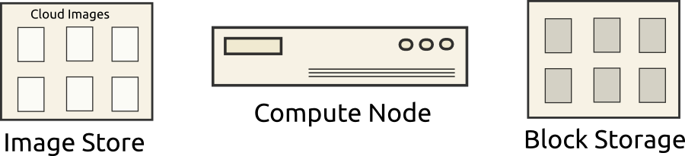
VM Provisioning: Stage I – Initial State

Slide 9
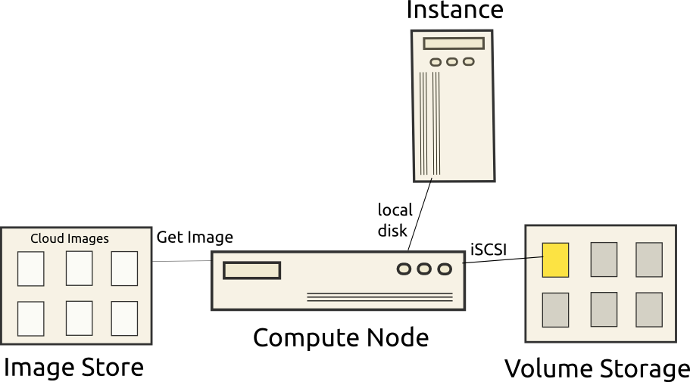
VM Provisioning: Stage II – VM launched

Slide 10
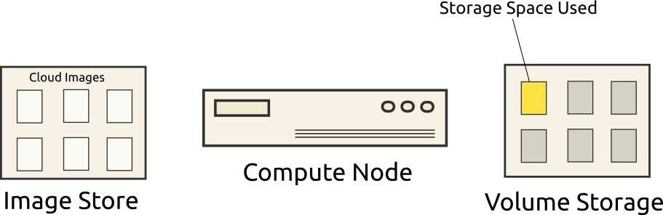
VM Provisioning: Stage III – Storage

Slide 11
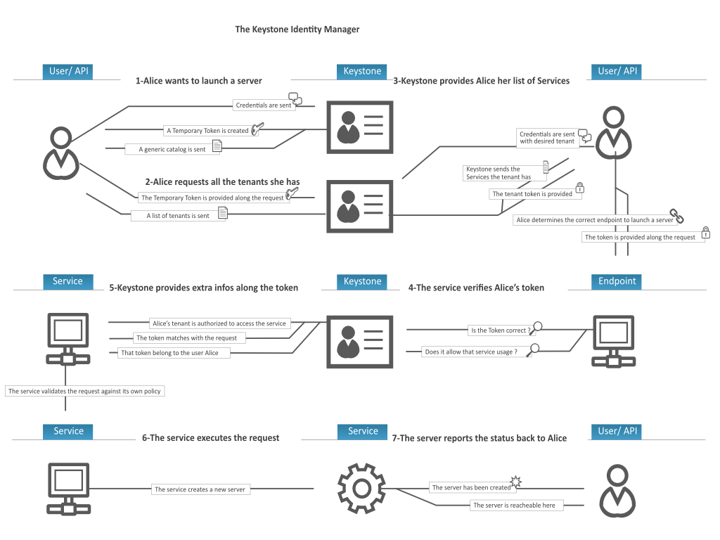
Keystone Service
Notes:
The Identity service performs these functions:
User management. Tracks users and their permissions.
Service catalog. Provides a catalog of available services with their API endpoints.
To understand the Identity Service, you must understand these concepts:
UserDigital representation of a person, system, or service who uses OpenStack cloud services. Identity authentication services will validate that incoming request are being made by the user who claims to be making the call. Users have a login and may be assigned tokens to access resources. Users may be directly assigned to a particular tenant and behave as if they are contained in that tenant.
CredentialsData that is known only by a user that proves who they are. In the Identity Service, examples are:
Username and password
Username and API key
An authentication token provided by the Identity Service
AuthenticationThe act of confirming the identity of a user. The Identity Service confirms an incoming request by validating a set of credentials supplied by the user. These credentials are initially a username and password or a username and API key. In response to these credentials, the Identity Service issues the user an authentication token, which the user provides in subsequent requests.
TokenAn arbitrary bit of text that is used to access resources. Each token has a scope which describes which resources are accessible with it. A token may be revoked at anytime and is valid for a finite duration.
While the Identity Service supports token-based authentication in this release, the intention is for it to support additional protocols in the future. The intent is for it to be an integration service foremost, and not aspire to be a full-fledged identity store and management solution.
TenantA container used to group or isolate resources and/or identity objects. Depending on the service operator, a tenant may map to a customer, account, organization, or project.
ServiceAn OpenStack service, such as Compute (Nova), Object Storage (Swift), or Image Service (Glance). Provides one or more endpoints through which users can access resources and perform operations.
EndpointAn network-accessible address, usually described by URL, from where you access a service. If using an extension for templates, you can create an endpoint template, which represents the templates of all the consumable services that are available across the regions.
RoleA personality that a user assumes that enables them to perform a specific set of operations. A role includes a set of rights and privileges. A user assuming that role inherits those rights and privileges.
In the Identity Service, a token that is issued to a user includes the list of roles that user can assume. Services that are being called by that user determine how they interpret the set of roles a user has and which operations or resources each role grants access to.

Slide 12
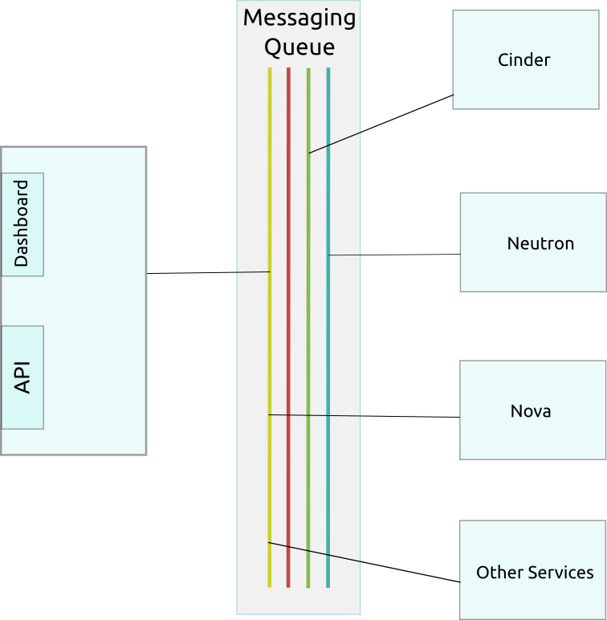
Messaging in OpenStack

Slide 13
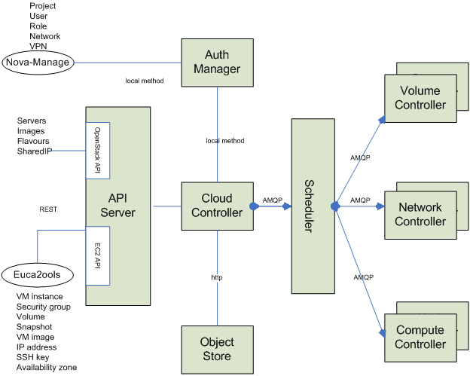
Messaging in Openstack Part II

Slide 14
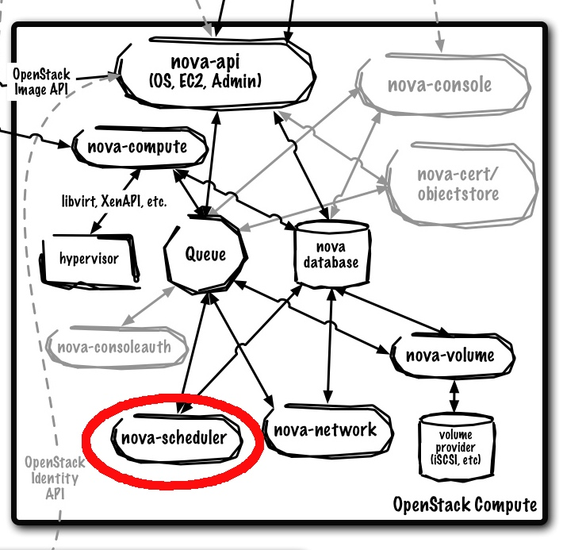
Allocating VM to a hypervisor node

Slide 15
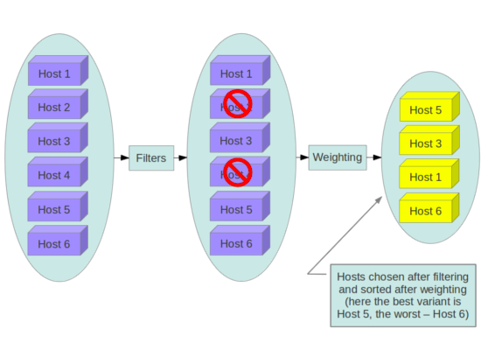
Host Allocation Policy

Slide 16
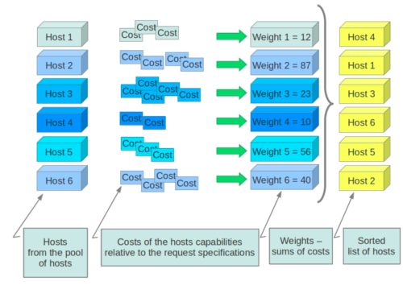
Calculating Weighted Cost in Nova

Slide 17
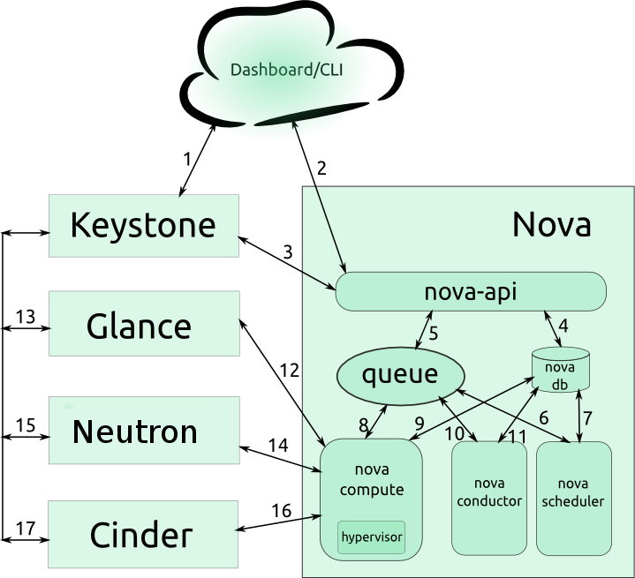
Nova VM allocation

Slide 18
Questions and Answers

